Slide 1

DAYANANDA SAGAR ACADEMY OF TECHNOLOGY & MANAGEMENT
DEPARTMENT OF COMPUTER SCIENCE AND ENGINEERING
(An Autonomous Institute under VTU)
MINI PROJECT REVIEW - 2023-24
Subject Name | MINI PROJECT | Subject Code | 21CSMP67
Student Name | Praveen Kumar | USN | 1DT22CS411
 | Raghuveer K J |  | 1DT22CS413
 | Sudeep J S |  | 1DT22CS415
 | Vikram S |  | 1DT22CS416
Domain | Machine Learning | Group No: | C18
Project Title | Crop Recommendation
Guide Name | Kalpa R

Slide 2
Agenda
Introduction
Literature Survey
Objective
Problem Statement
Methods
Design/Approach:
Data Collection:
Analysis:
References

Slide 3
Introduction
Objective of this project is to use the methods of machine learning in agriculture to recommend the farming crop recommendation. Goal is to increase the crop yield by recommending a suitable crop for their land with the help of geographic and the climatic parameters
Crop recommendation involves utilizing data on soil, climate, and other factors to suggest the optimal crops for a specific region, promoting efficient and sustainable agriculture practices

Slide 4
Literature Survey
SL.NO | Name of researcher, Year of Publication | Paper title | Methodology Adopted / Modules Used | Observations Noted
1 | Ji-chun Zhao, Jian-xin Guo, 2018 | Big Data Analysis Technology Application in Agricultural Intelligence Decision System | 1.Inference engine 2.Domain expertise 3.Knowledge engineering 4.Knowledge acquisition module 5.Knowledge base for recommendation system | 1. Large database of crops 2. Processed using Hadoop 3. Professional knowledge 4. Past experiences 5. Feature selection using HDFS 6. Future Scope: Using Hadoop with Artificial Neural Network
2 | Shruti Mishra Priyanka Paygude, 2018 | Use of Data Mining in Crop Yield Prediction | 1. J48 2. LAD tree 3. LWL 4. IBK algorithm | 1. WEKA tool 2. LAD tree showed the lowest accuracy 3. Errors can be minimized by pruning the tree 4. IBK was observed to achieve higher accuracy
3 | Miftahul Jannat Mokarrama, 2017 | RSF: A Recommendation System for Farmers | 1.Location Detection 2.Data analysis and storage 3.Similar location detection 4. Recommendation generation module | 1. Physiographic, thermal, crop growing period, crop production rate 2. Seasonal crop database 2. Similar location detection 3. Generating the set of crops 4. Similarity between the crops planted in a region

Slide 5
Literature Survey
SL.NO | Name of researcher, Year of Publication | Paper title | Methodology Adopted / Modules Used | Observations Noted
4 | Yogesh Gandge, Sandhya, 2017 | A Study on Various Data Mining Techniques for Crop Yield Prediction | 1. Attribute selection 2. Multiple Linear Regression 3. Decision Tree using ID3 4. SVM 5. Neural Networks 6. C4.5 8. K-means and KNN | 1. Selection of agricultural field 2. Selection of crop previously planted 3. Input from user 4. Preprocess 5. Attribute Selection 6. Classification algorithm on data 7. Crop is recommended
5 | S.Pudumalar, E.Ramanujam, 2016 S.Pudumalar, E.Ramanujam, 2016 | Crop Recommendation System for Precision Agriculture Crop Recommendation System for Precision Agriculture | 1. Random tree 2. CHAID 3. KNN 4. Naïve Bayes 5. WEKA tool | 1. Pre-processing of data 2. Handling missing and out-ofrange values 3. Feature extraction 4. Ensemble model to get higher accuracy 5. Rule generation

Slide 6
Introduction - Objectives
Maximize Yield and Profitability:
Identify crops suited to local conditions for higher yields and profitability.
Sustainable Agriculture:
Promote eco-friendly practices and long-term soil health.
Resource Optimization:
Optimize water, fertilizer, and pesticide use for efficient resource management.
Risk Mitigation:
Diversify crop recommendations to reduce weather and disease-related risks.

Slide 7
Problem Statement
In most circumstances, a farmer's decision on which crop to cultivate is impacted by his intuition as well as other irrelevant aspects such as generating fast profits, being oblivious of market demand, overestimating the potential of a soil, and so on.
The farmer's unwise decision could put his family's financial status under severe strain. Perhaps this will lead to debt, which is one of the numerous contributing factors to the significant number of farmer suicides and decline in the number of farmers.
Solution
We propose an Intelligent Crop Recommendation and Yield prediction system using Machine Learning that predicts crop suitability by factoring all relevant data such as temperature, rainfall, location, and soil condition.
The Yield is predicted based on the parameters of area of land available, agricultural season and the past observations of yield prediction
This system is primarily concerned with performing Agro Consultants principal role, which is to provide crop recommendations to farmer and the expected yield for that crop.

Slide 8
Methods
Design/Approach:
Data Collection:
Analysis:
.

Slide 9
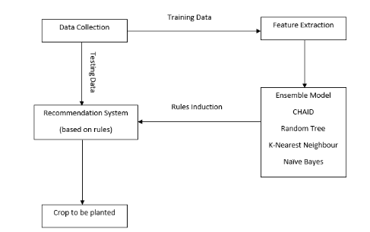
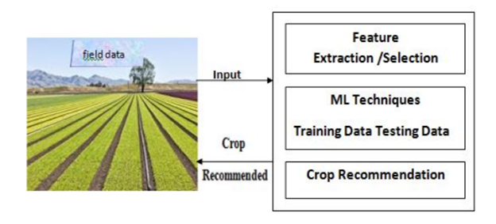
Design Approach
The recommendation system is designed based on the necessary attributes such as the geographic and the climatic parameters with the region, soil type, nutrient contents of the soil, temperature and groundwater level the crop.

Slide 10
Data Collection
Dataset(Crop Recommendation) consists of 8 variables where 7 variables are considered for predicting output variable. The details of Variable is given Below
%N (Nitrogen) : Nitrogen content in the soil. Nitrogen is really important for plant growth (structure), plant food processing (metabolism), and the creation of chlorophyll. Without enough nitrogen in the plant, the plant cannot grow taller, or produce enough food (usually yellow).
%P (Phosphorus) : Phosphorus content in the soil. Phosphorus primary role in a plant is to store and transfer energy produced by photosynthesis for use in growth and reproductive processes. Soil P cycles in a variety forms in the soil
%K (Potassium) : Potassium content in the soil. Potassium is an essential nutrient for plant growth.
Temperature : Temperature in degree celsius. High temperatures affect plant growth in numerous ways. The most obvious are the effects of heat on photosynthesis, in which plants use carbon dioxide to produce oxygen, and respiration, an opposite process in which plants use oxygen to produce carbon dioxide.
Humidity : Relative humidity in %. When conditions are too humid, it may promote the growth of mold and bacteria that cause plants to die and crops to fail, as well as conditions like root or crown rot. Humid conditions also invite the presence of pests, such as fungus gnats, whose larvae feed on plant roots and thrive in moist soil.
PH : ph value of the soil. Plant nutrients leach from the soil much faster at pH values below 5.5 than from soils within the 5.5 to 7.0 range. In some mineral soils aluminum can be dissolved at pH levels below 5.0 becoming toxic to plant growth. Soil pH may also affect the availability of plant nutrients.
Rainfall : Rainfall in mm. Plants use the moisture in the soil to replenish the water lost through transpiration. If there is no water in the soil, the leaves will wilt. As more water is lost, the plant will fail and eventually die. Rainwater builds up the moisture levels in the soil and assures a healthy plant. Finally,
Label : This is the output variable which contains 22 unique values i.e., 22 different crops and they are ['Apple','Banana','blackgram','chickpea','coconut','coffee','cotton','grapes','jute','kidney beans','lentil','maize','mango','moth beans','mung bean','muskmelon','orange','papaya','pigeonpeas','pomegranate','Rice','Watermelon']

Slide 11
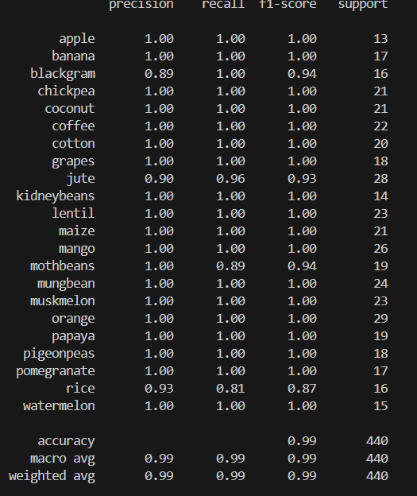
Analysis
Crop analysis and prediction is a rapidly growing field that plays a vital role in optimizing agricultural practices. Crop recommendation plays a pivotal role in agriculture, empowering farmers to make informed decisions about the most suitable crops for their specific land and climate conditions.

Slide 12
References
[1] 2017 International Conference on I2C2, “Agriculture decision support system using data mining”, Prof. Rakesh Shirsath; Neha Khadke; Divya More.
[2] 2018 the 3rd IEEE International Conference on Cloud Computing and Big Data Analysis, “Big Data Analysis Technology Application in Agricultural Intelligence Decision System”, Ji-chun Zhao; Jian-xin Guo.
[3] 2017 IEEE Region 10 Humanitarian Technology Conference, “RSF: A Recommendation System for Farmers”, Miftahul Jannat Mokarrama; Mohammad Shamsul Arefin.
[4] 2016 IEEE Eighth International Conference on Advanced Computing (ICoAC), “Crop Recommendation System for Precision Agriculture”, S.Pudumalar*, E.Ramanujam*, R.Harine Rajashreeń, C.Kavyań, T.Kiruthikań, J.Nishań.
[5] 2017 International Conference on Electrical, Electronics, Communication, Computer and Optimization Techniques (ICEECCOT), “A Study on Various Data Mining Techniques for Crop Yield Prediction”, Yogesh Gandge, Sandhya.

Slide 13
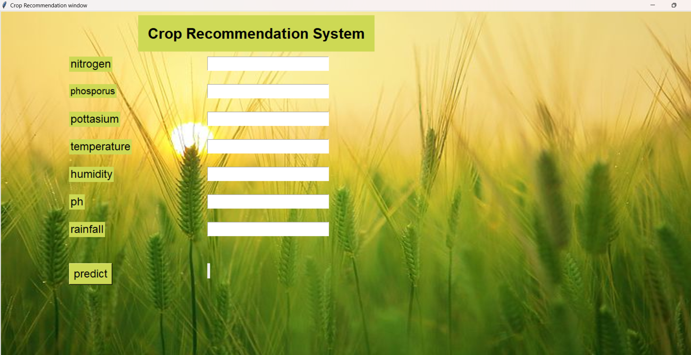
Sample Output

Slide 14
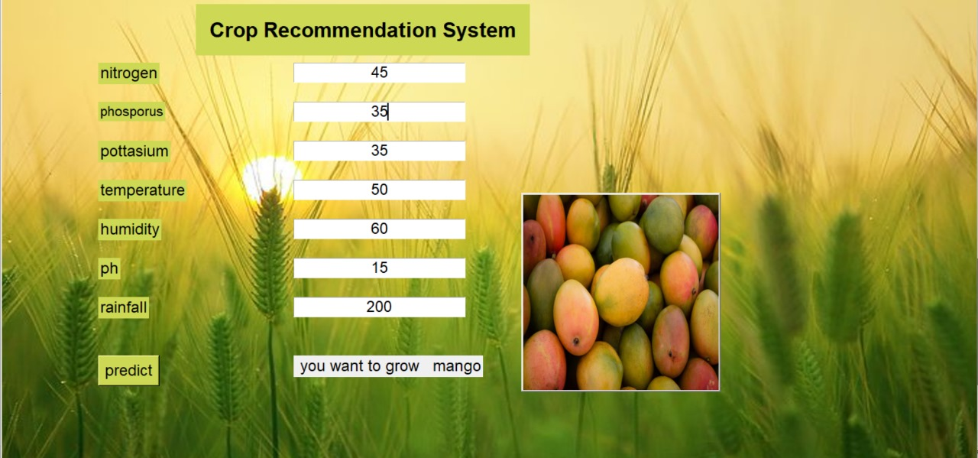
Sample Output

Slide 15
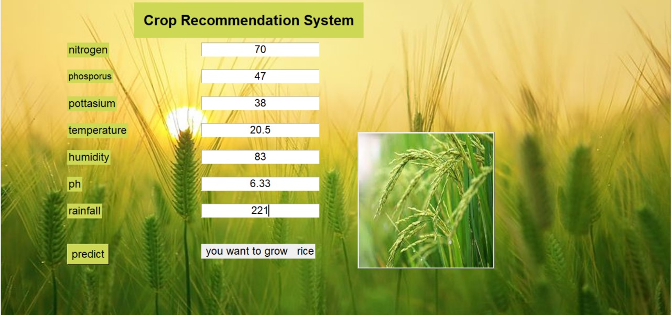
Sample Output

Slide 16
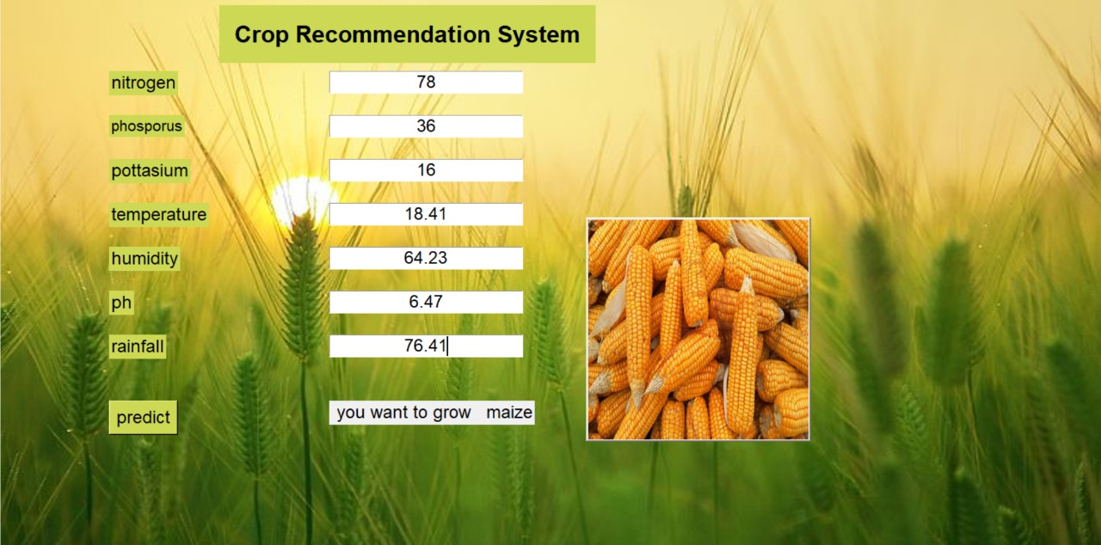
Sample Output

Slide 17
Thank You

